Slide 1
Implementation of Smart Home Automation System with IoT
Minor Project

Slide 2

Project Presentation
Team Members
Mentor
Ankit Paul
00520902818
Rajat Tiwari
41220902818
Ms. Mamta
Assistant Professor ECE

Slide 3
Objective
1
Understanding the basics of internet of things and its
working.
2
Using those concepts to implement the automation of home appliances.

Slide 4
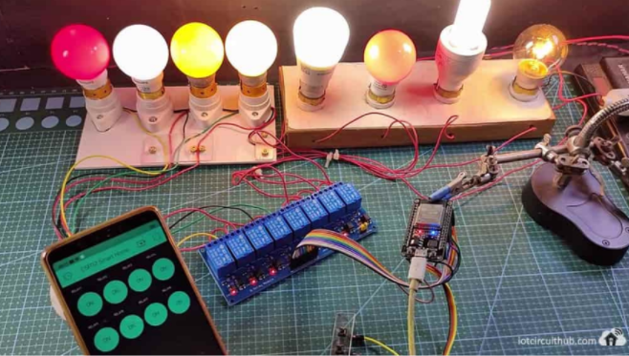
Introduction
This project aims to develop a smart home automation system that implements the internet of things (IoT) using a Wi-Fi-based microcontroller (ESP32) that is interfaced with a JavaScript-based android app. With this, one can control the home appliances from the smartphone and manual switches. If there is no internet available still one can control the relay module from the manual push buttons.

Slide 5
Internet of Things (IoT)
Internet of Things (IoT) defines tangible objects (or groups of such objects) embedded with sensors, processing capabilities, software, and other technologies, and that connects and exchanges data with other devices and systems via the Internet or other communication networks.
What technologies made IoT possible
Low cost, low power sensor technology
Connectivity
Cloud Computing platforms

Slide 6
How IoT works ?
Sensors/Devices
Connectivity
01
02
Data Processing
User Interface
03
04
Sensors or devices collect data from their environment.
That data is sent to the cloud via Wi-Fi.
Software performs some kind of processing on it.
the information is made useful to the end-user in some way.

Slide 7
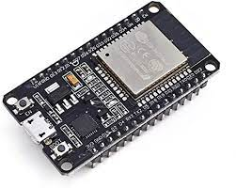
Technologies used in this project
ESP-32 Module
ESP32 is a single 2.4 GHz Wi-Fi-and-Bluetooth combo chip designed with the TSMC ultra
low-power 40 nm technology. It is designed to achieve the best power and RF performance,
showing robustness, versatility and reliability in a wide variety of applications and power
scenarios.

Slide 8
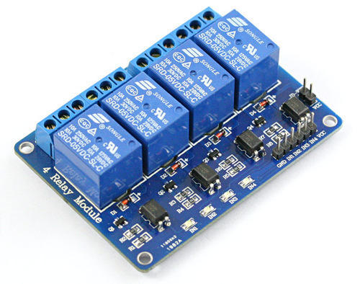
Technologies used in this project
Relay Board
This is a LOW Level 5V 4-channel relay interface board, and each channel needs a 15-20mA
driver current. It can be used to control various appliances and equipment with large current.
It is equipped with high-current relays that work under AC250V 10A or DC30V 10A. It has
a standard interface that can be controlled directly by microcontroller. This module is
optically isolated from high voltage side for safety requirement and also prevent ground loop
when interface to microcontroller.

Slide 9
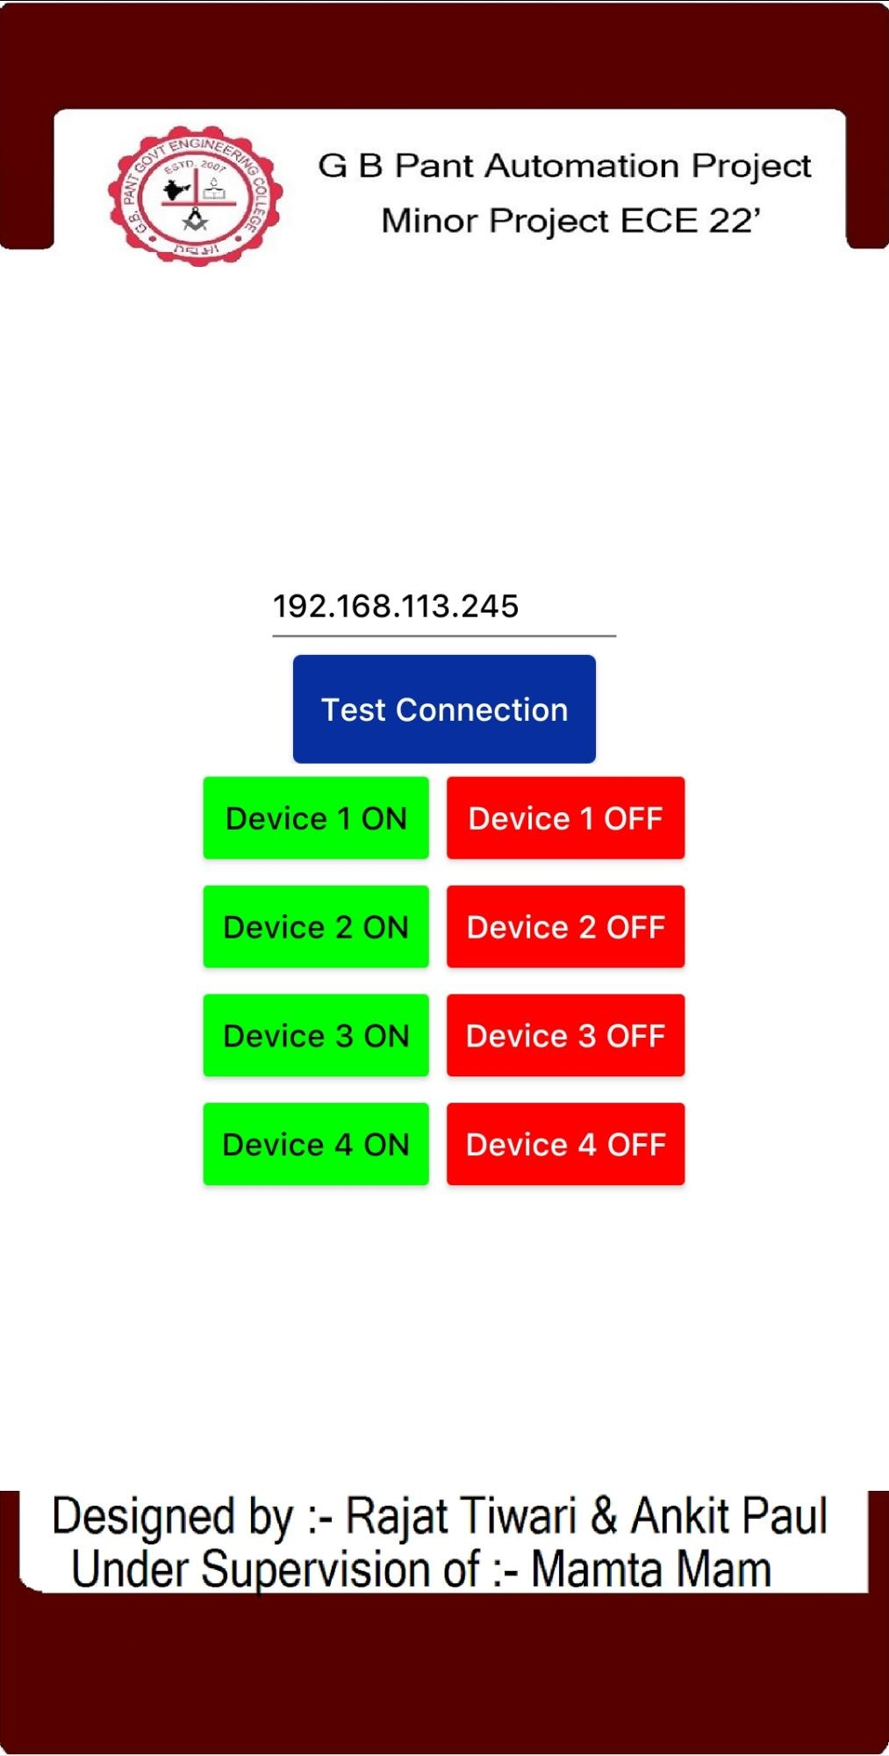
Technologies used in this project
Android app (GBPEC_Automation)
A JavaScript-based android app. With this, one can control the home appliances.

Slide 10
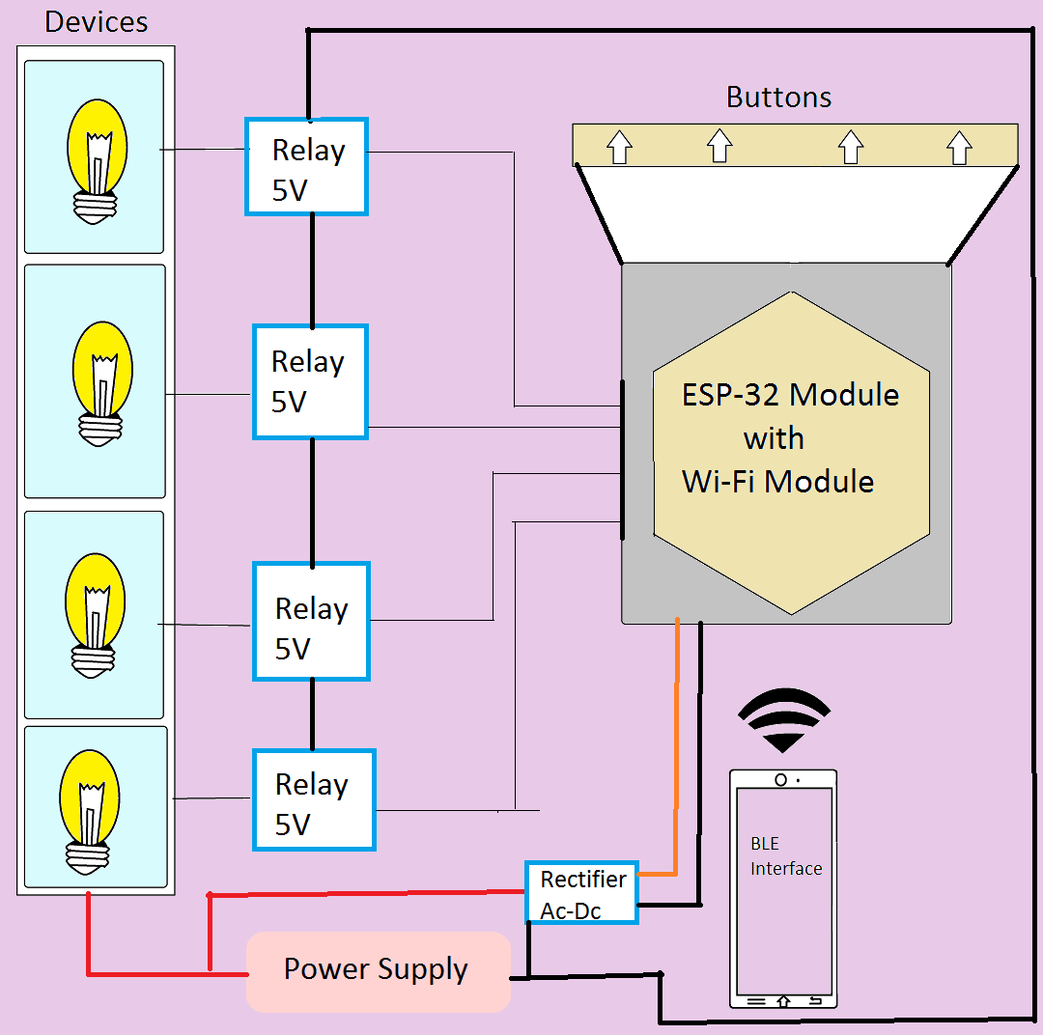
Functional Diagram of Home automation
Working components involved & their cost & brand estimation.
ESP-32
BLE
Wide-range of BT connectivity
Reduced power Consumption
Relay 5 v
- Faster switching
- Better connections
Rectifier Circuit
Tensilica Xtensa LX6 microprocessor 240 MHz
Built-in antenna,power amplifier & filters
built-in power management modules

Slide 11
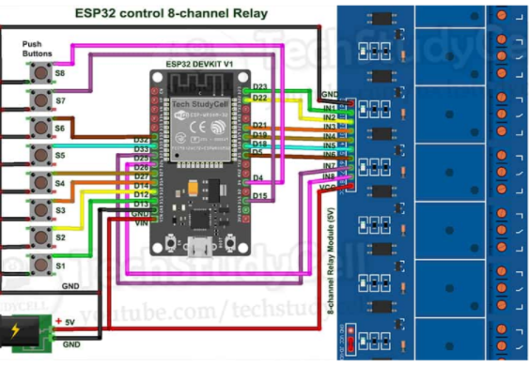
ESP-32 home automation circuit
D23, D22, D21, D19, D18, D5, D25 & D26 GPIO to control the 8-channel relay module.
And the GPIO D13, D12, D14, D27, D33, D32, D15 & D4
connected with push buttons to control the relay module
manually.
As per the source code, when the control pins of the relay
module receive LOW signal the relay will turn on and the
relay will turn off for the HIGH signal in the control pin.

Slide 12
Methodology
Microcontroller
Interface
A microprocessor with better power consumption history and optimum processing power is chosen to act as the central unit of IoT device.
Testing and rectification
All the controls and states are depicted over an interface such as a typical JavaScript android app that facilitates the control
The device is tested for multiple stress test that provide us a preview of long run implacability of device and required changes are entertained before final binding of components
1
2
3
4
5
Connectivity
Actuator
ASync webserver is initiated at the microcontroller to accept HTTP requests and provide controlled access to the devices connected to the microcontroller.
A Low state high relay board act as a switching element that controls 230V operated appliances on a 5v intent from the microcontroller.

Slide 13

Setting up the Microcontroller

Slide 14

Setting up the Interface

Slide 15

Assembling the project

Slide 16
Codes
#include <WiFi.h>
String ClientRequest;
IPAddress staticIP303_10(192,168,1,10);
IPAddress gateway303_10(192,168,1,1);
IPAddress subnet303_10(255,255,255,0);
WiFiServer server(80);
WiFiClient client;
String myresultat;
String ReadIncomingRequest(){
while(client.available()) {
ClientRequest = (client.readStringUntil('\r'));
if ((ClientRequest.indexOf("HTTP/1.1")>0)&&(ClientRequest.indexOf("/favicon.ico")<0)){
myresultat = ClientRequest;
}}
return myresultat;
}

Slide 17
void setup()
{
ClientRequest = "";
Serial.begin(9600);
pinMode(21, OUTPUT);
pinMode(23, OUTPUT);
pinMode(25, OUTPUT);
pinMode(27, OUTPUT);
pinMode(2, OUTPUT);
digitalWrite(21,HIGH);
digitalWrite(23,HIGH);
digitalWrite(25,HIGH);
digitalWrite(27,HIGH);
WiFi.disconnect();
delay(3000);
Serial.println("START");
WiFi.begin("esp32","Tiwariji");
while ((!(WiFi.status() == WL_CONNECTED))){
delay(300);
Serial.print("..");
}
Serial.println("Connected");
Serial.println("Your IP is");
Serial.println((WiFi.localIP()));
server.begin();
}
void loop()
{ client = server.available();
if (!client) { return; }
while(!client.available()){ delay(1); }
ClientRequest = (ReadIncomingRequest());
ClientRequest.remove(0, 5);
ClientRequest.remove(ClientRequest.length()-9,9);

Slide 18
if (ClientRequest == "r10") {
digitalWrite(21,HIGH);
Serial.print("Relay 1 OFF\n");
}
if (ClientRequest == "r11") {
digitalWrite(21,LOW);
Serial.print("Relay 1 ON\n");
}
if (ClientRequest == "r20") {
digitalWrite(23,HIGH);
Serial.print("Relay 2 OFF\n");
}
if (ClientRequest == "r21") {
digitalWrite(23,LOW);
Serial.print("Relay 2 ON\n");
}
if (ClientRequest == "r30") {
digitalWrite(25,HIGH);
Serial.print("Relay 3 OFF\n");
}
if (ClientRequest == "r31") {
digitalWrite(25,LOW);
Serial.print("Relay 3 ON\n");
}
if (ClientRequest == "r40") {
digitalWrite(27,HIGH);
Serial.print("Relay 4 OFF\n");
}
if (ClientRequest == "r41") {
digitalWrite(27,LOW);
Serial.print("Relay 4 ON\n");
}
if (ClientRequest == "test") {
digitalWrite(2,HIGH);
delay(3000);
digitalWrite(2,LOW);
Serial.print("Test conection succesfull\n");
}

Slide 19
if(!(WiFi.status() == WL_CONNECTED))
{
Serial.print("Wifi disconnected\n");
delay(3000);
Serial.print("Setting up again\n");
goto setup();
}
client.println("HTTP/1.1 200 OK");
client.println("Content-Type: text/html");
client.println("");
client.println("<!DOCTYPE HTML>");
client.println("<html>");
client.println("OK");
client.println("</html>");
client.stop();
delay(1);
client.flush();
}

Slide 20
Result
https://drive.google.com/file/d/16_VPuUTdx-K326Hl8FqSvkhHizXaIobK/view?usp=drivesdk

Slide 21
Literature surveys
• 1 .Kusuma S M, Assistant Professor, Department of telecommunication, MSRIT, Bangalore, India. “Home Automation Using Internet of Things.”
• 2.Niharika Shrotriya, Anjali Kulkarni, Priti Gadhave, International Journal of Science, Engineering and Technology Research (IJSETR), “SMART HOME USING WI-FI”
•3. Anushri Aware, Sonali Vaidya,Priyanka Ashture, Varsha Gaiwal PES’s Modern College of Engineering, Pune-04, International Journal of Engineering Research and General Science Volume 3, “Home Automation using Cloud Network”

Slide 22
Timeline
1st week of Sept – 3rd week of Sept.
1st week of Oct.
Project idea refining & data collection phase
Final Modification & rectification after review.
Project completion & Final Submission to board of respected department
1
2
3
4
5
4th week of Sept.
2nd week of Oct.
Project structure modelling along with planning & documentation
Practically developing the project & handling challenges related to it

Slide 23
References (1/2)
[1] M. Jung, C. Reinisch and W. Kastner, “Integrating Building Automation Systems and IPv6 in the Internet of Things,” 2012 Sixth International Conference on Innovative Mobile and Internet Services in Ubiquitous Computing, Palermo, 2012, pp. 683-688.
[2] M. Jain, N. Kaushik and K. Jayavel, “Building automation and energy control using IoT - Smart campus,” 2017 2nd International Conference on Computing and Communications Technologies (ICCCT), Chennai, 2017, pp. 353-359.
[3] S. Spinsante et al., “A LoRa enabled building automation architecture based on MQTT,” 2017 AEIT International Annual Conference, Cagliari, 2017, pp. 1-5.
[4] T. Supramaniam, R. Ibrahim, S. M. Hassan and K. Bingi, “Development of WirelessHART adapter with industrial transmitter for process monitoring,” 2017 IEEE International Conference on Signal and Image Processing Applications (ICSIPA), Kuching, 2017, pp. 294-298.
[5] F. D. Arcari et al., “Development of a WirelessHART - EnOcean Adapter for Industrial Applications,” 2017 VII Brazilian Symposium on Computing Systems Engineering (SBESC), Curitiba, 2017, pp. 181-186.
[6] B. Kang, D. Kim and H. Choo,“Internet of Everything: A LargeScale Autonomic IoT Gateway,” in IEEE Transactions on Multi-Scale Computing Systems, vol. 3, no. 3, pp. 206-214, 1 July-Sept. 2017.

Slide 24
References (2/2)
[7] J. Huang and H. Hsieh, “Design of Gateway for Monitoring System in IoT Networks,” 2013 IEEE International Conference on Green Computing and Communications and IEEE Internet of Things and IEEE Cyber, Physical and Social Computing, Beijing, 2013, pp. 1876-1880.
[8] VDMA-Forum Industrie 4.0 (2018), “Guideline Sensors for Industrie 4.0,” [Online]. Available: https://industrie40.vdma.org/documents/ 4214230/25447567/Guideline+Sensors+for+Industrie+40.pdf
[9] J. Weiss, R. Yu, “Wireless Sensor Networking for the Industrial Internet of Things,” Analog Devices White Paper WP007. [Online]. Available: https://www.analog.com/media/en/technicaldocumentation/ white-papers/wp007fa.pdf
[10] Industrial Wireless, Phoenix Contact. [Online]. Available: https://www.phoenixcontact.com/assets/downloads ed/global/web dwl promotion/52001683 EN HQ Industrial wireless LoRes.pdf
[11] Wireless Industrial Sensor Interface, BEI Sensors. [Online]. Available: https://www.mouser.com/pdfdocs/bei-sensors wireless industrial sensors interface swiftcomm.pdf [12] Cloud Connection Guide, Belimo Automation. [Online]. Available: https://www.belimo.com/mam/americas/pictures and graphics/ marketing/teaser images/iot/MAN18 Belimo Connection Guide EN-US.pdf
[12] Cloud Connection Guide, Belimo Automation. [Online]. Available: https://www.belimo.com/mam/americas/pictures and graphics/ marketing/teaser images/iot/MAN18 Belimo Connection Guide EN-US.pdf

